Slide 1


High Cloud Airlines
Presented By Group 6
JANIGE DAYAKAR
CHANJAL M
Khandagale Aniket
Pratik Vijaykumar Baile
MR. RAGHAVENDRA REDDY P
Anjali Anil Varma

Slide 2
Content
Introduction
Data Transformation
KPI 1 - Date Calculations
KPI 2 - Load Factor % (Yearly, Quarterly, Monthly)
KPI 3 - Load Factor % by Carrier Name
KPI 4 - Top 10 Carrier Names Based on Passenger Preference
KPI 5 - Top Routes (From–To City) Based on Number of Flights
KPI 6 - Load Factor on Weekend vs Weekdays
KPI 7 - Number of Flights Based on Distance Group
Dashboard using Excel, Power BI, Tableau
Conclusion

Slide 3

INTRODUCTION
The High Cloud Airlines Dashboard is a comprehensive data analytics project designed to analyze airline operational efficiency and passenger travel behavior. The main objective of this project is to understand how effectively airlines utilize their available seats, identify top-performing carriers and routes, and analyze travel patterns across time, distance, and day type (weekday vs weekend).
This project uses Excel, Power BI, and Tableau to transform raw airline data into interactive dashboards and business insights that help stakeholders improve capacity planning, route optimization, and revenue management.

Slide 4
DATA TRANSFORMATION
Before creating dashboards, extensive data cleaning and transformation was performed.
Key Transformation Steps
Combined Year, Month, and Day fields to create a proper Date column
Extracted:
Year
Month Number
Month Name
Quarter (Q1–Q4)
Year-Month (YYYY-MMM)
Weekday Number & Weekday Name
Classified dates into Weekday and Weekend
Grouped flight distances into Distance Intervals
Removed null values and ensured consistent data formats
Created calculated fields and measures for Load Factor and KPIs.
These transformations ensured accurate time-based analysis and clean reporting.

Slide 5
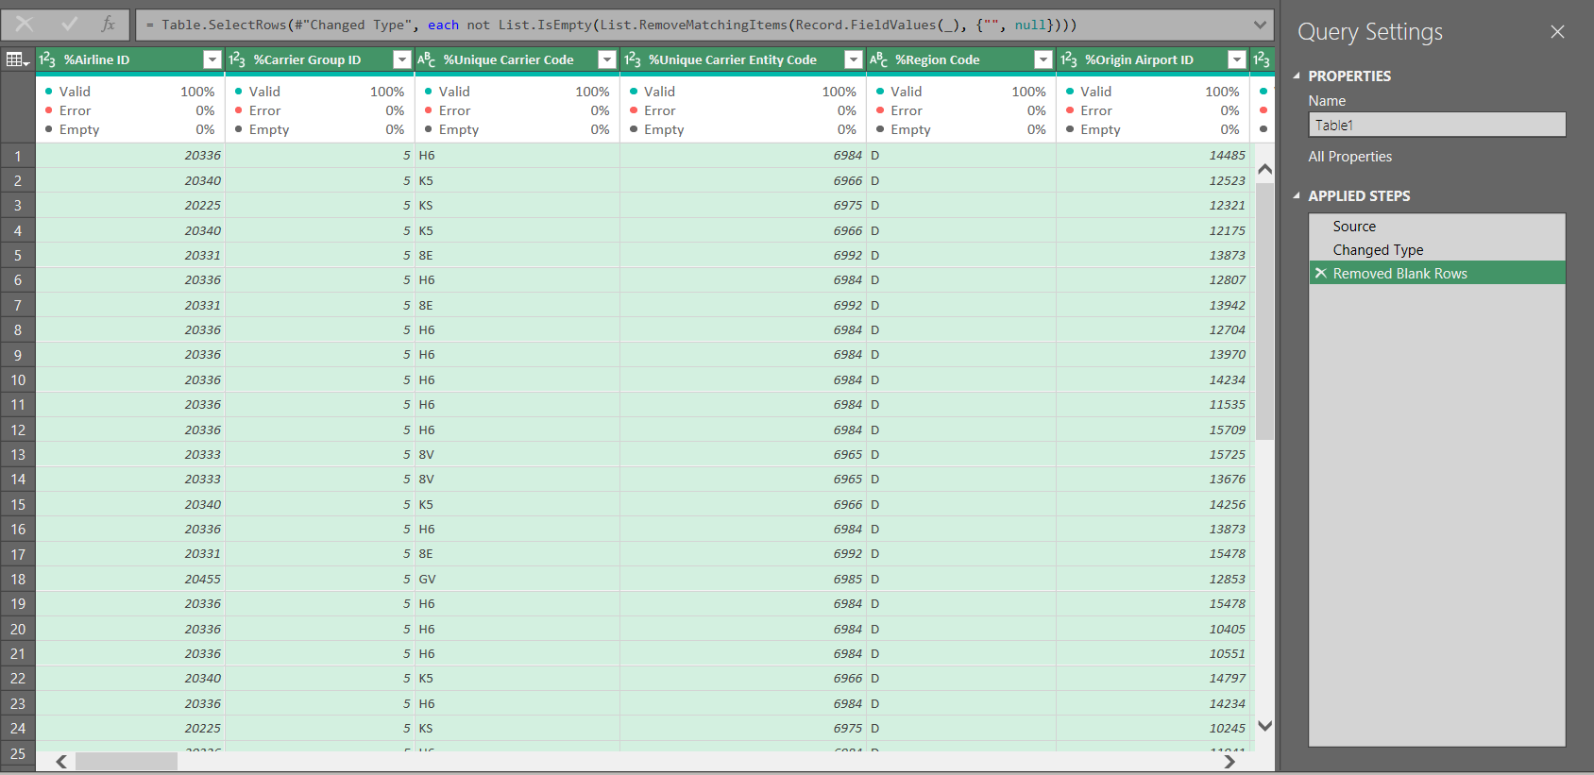

Slide 6
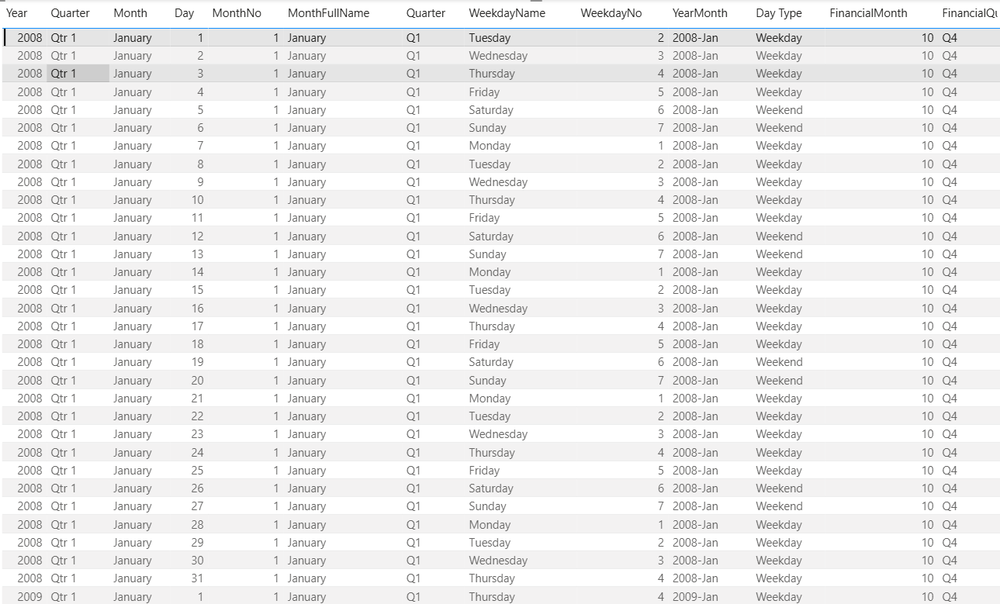
KPI 1 – Date Calculations
Objective
Create a single Date field using Year, Month, and Day and derive multiple time attributes.
Calculated Fields
Year
Month Number
Month Name
Quarter (Q1, Q2, Q3, Q4)
Year-Month (YYYY-MMM)
Weekday Number
Weekday Name
Day Type (Weekday / Weekend)
📌 Purpose:
These fields enable trend analysis, seasonal analysis, and time-based filtering across all dashboards.

Slide 7
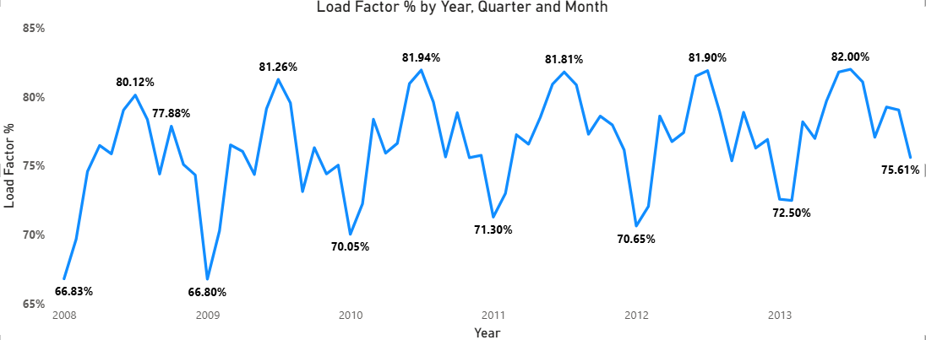
KPI 2 – Load Factor % (Yearly, Quarterly, Monthly)
Analysis
Load Factor is analyzed across Year → Quarter → Month
Shows how efficiently airline capacity is utilized over time
Identifies seasonal peaks and demand fluctuations.
📊 Insight Example
Load Factor shows a gradual improvement over years
Certain months and quarters have higher occupancy, indicating peak travel seasons

Slide 8
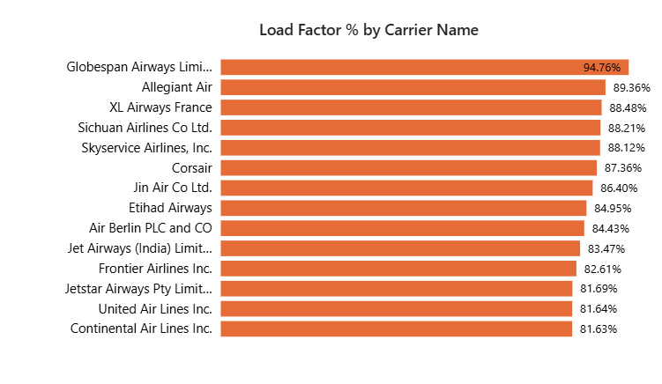
KPI 3 - Load Factor % by Carrier Name
Objective
Compare seat utilization efficiency across different airlines.
Analysis
Carriers like Globespan Airways, Allegiant Air, XL Airways France show higher load factors
Airlines with lower load factors indicate underutilized capacity
📌 Business Value
Helps airlines benchmark performance
Identifies efficient and inefficient carriers

Slide 9
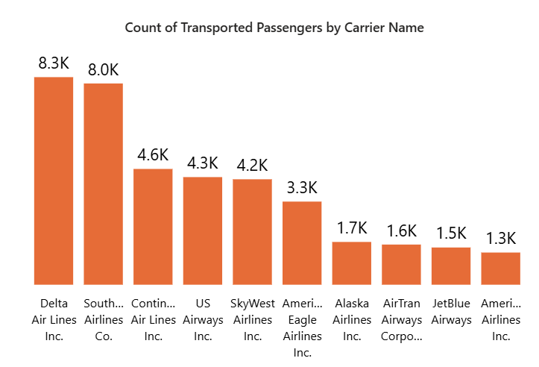
KPI 4 - Top 10 Carrier Names Based on Passenger
Objective
Identify the most preferred airlines based on total transported passengers.
Analysis
Airlines such as Delta Air Lines, Southwest Airlines, and American Airlines rank among the top
High passenger count indicates strong brand presence and route coverage
📊 Insight
Popular carriers maintain consistent passenger demand
Useful for competitive analysis and partnership decisions

Slide 10
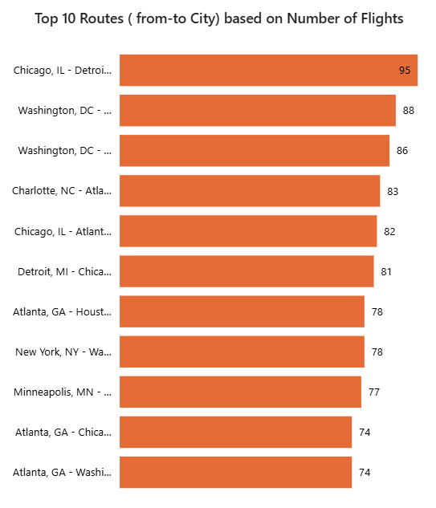
KPI 5 – Top Routes Based on Number of Flights
Objective
Identify the busiest routes based on number of flights operated.
Analysis
Routes like Chicago–Washington, Chicago–Charlotte, Atlanta–New York appear frequently
High flight frequency indicates high passenger demand and business importance
📌 Business Value
Helps in route optimization
Identifies strategic hubs and high-traffic corridors

Slide 11
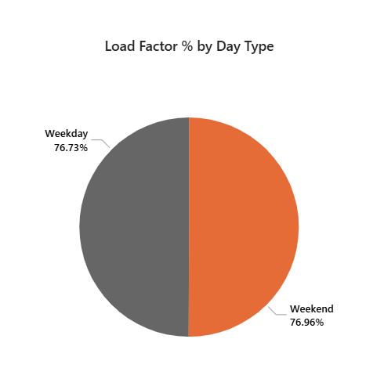
KPI 6 – Load Factor on Weekend vs Weekdays
Objective
Compare passenger occupancy between Weekdays and Weekends.
Analysis
Load Factor on Weekends and Weekdays is almost equal (~77%)
Indicates consistent travel demand throughout the week
📊 Insight
Airlines can maintain similar capacity planning for both day types
Supports stable scheduling strategies

Slide 12
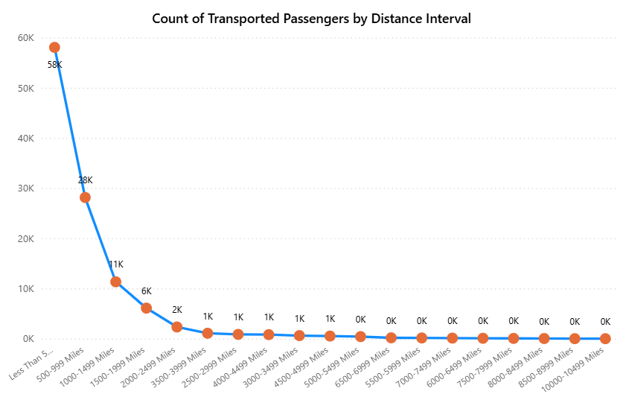
KPI 7 – Number of Flights Based on Distance Group
Objective
Analyze flight distribution based on distance intervals.
Analysis
Majority of flights fall under short-haul routes (Less than 500 miles)
Flight frequency decreases as distance increases
📌 Insight
Short-distance routes dominate airline operations
Long-haul routes are fewer but usually higher in revenue per flight

Slide 13
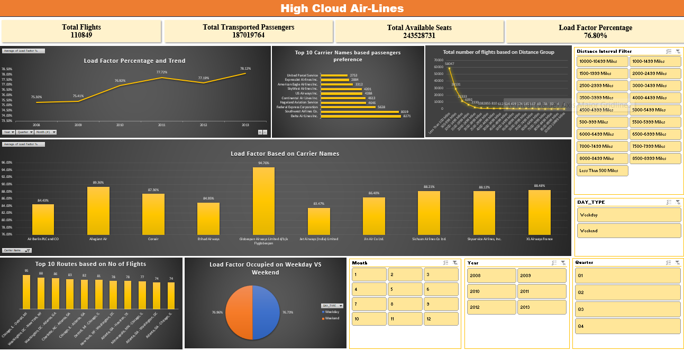
DASHBOARD USING EXCEL

Slide 14
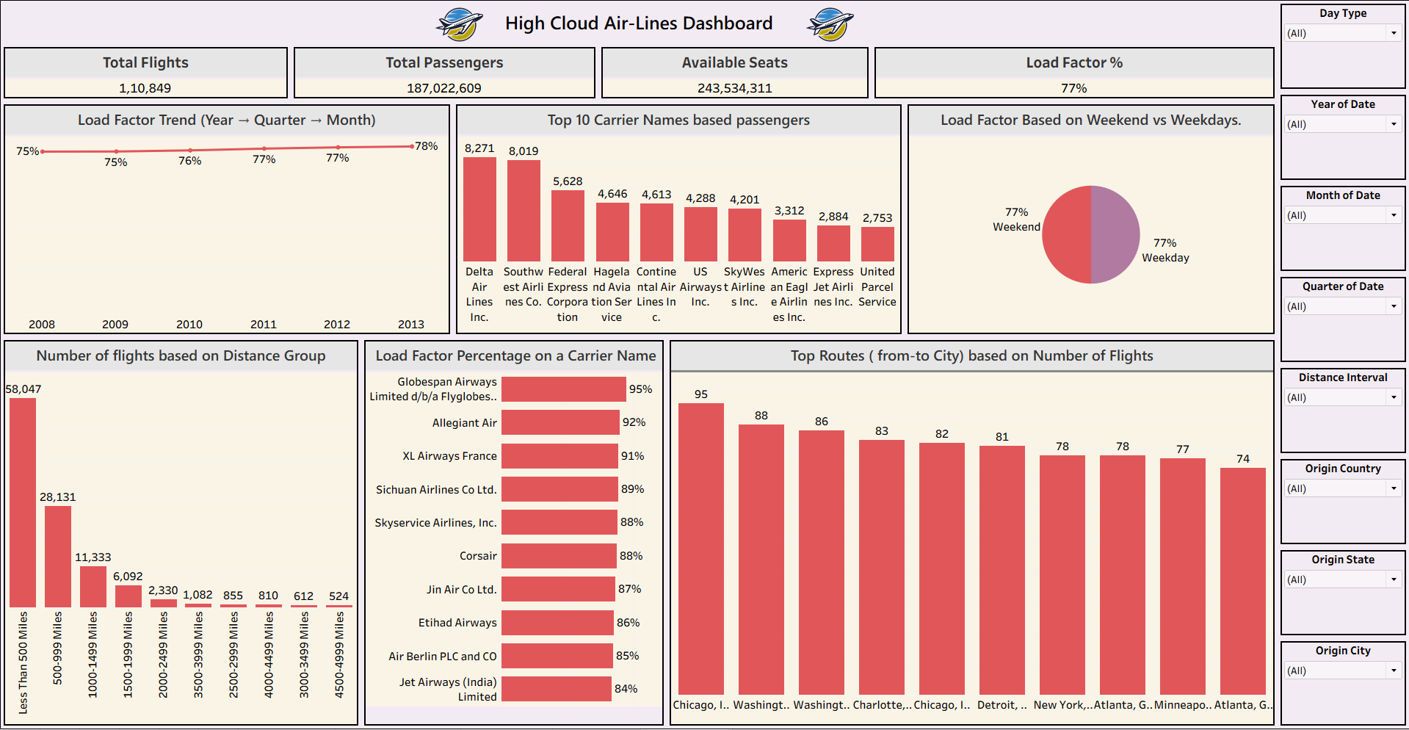
DASHBOARD USING TABLEAU

Slide 15
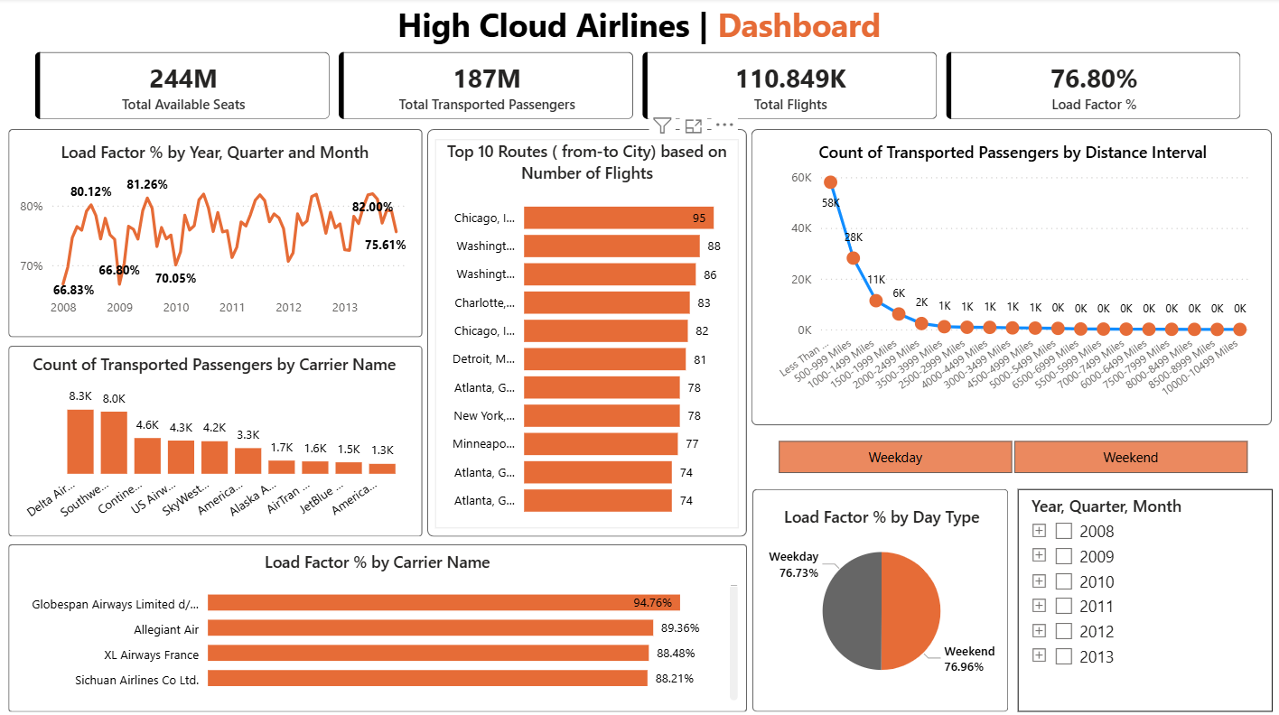
DASHBOARD USING POWER BI

Slide 16
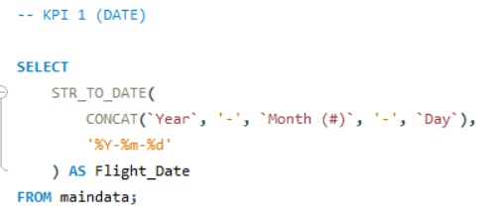
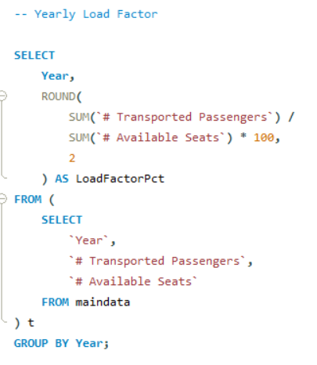
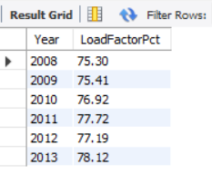
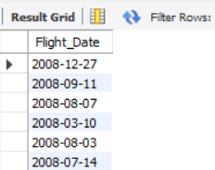
SQL QUERIES

Slide 17
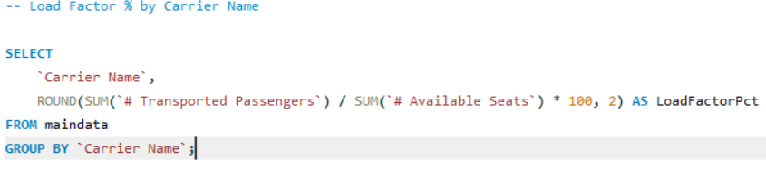
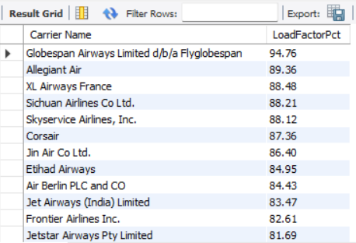
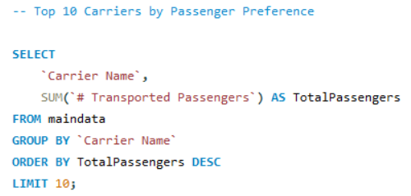
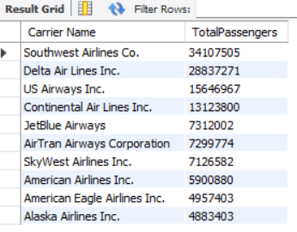
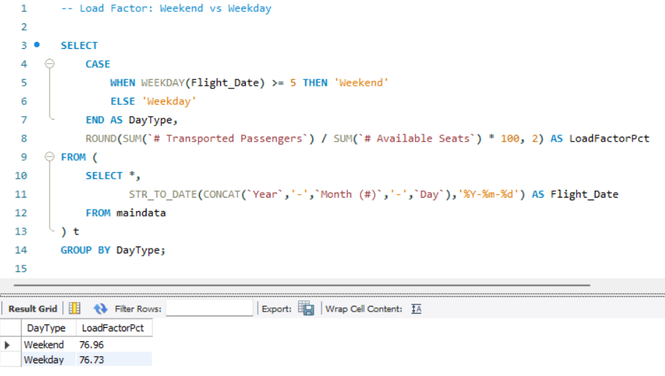
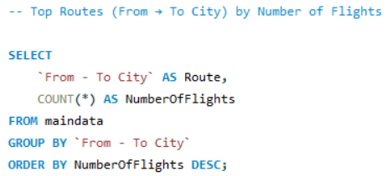
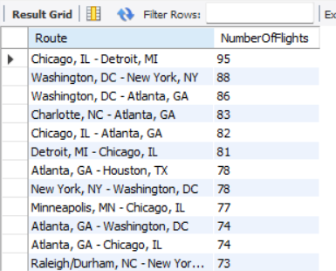

Slide 18
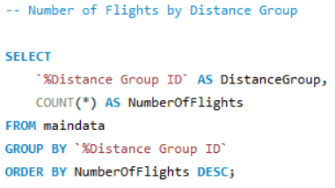
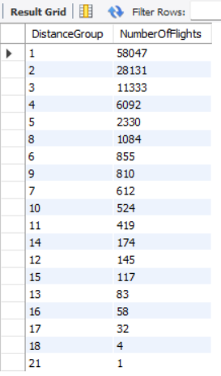

Slide 19
CONCLUSION
The High Cloud Airlines Dashboard successfully delivers actionable insights into airline operations by analyzing load factor efficiency, passenger preferences, route demand, and travel patterns.
Key Takeaways
Overall Load Factor remains around 76–77%
Certain carriers outperform others in seat utilization
Short-haul routes dominate flight operations
Passenger demand remains consistent across weekdays and weekends
Business Impact
This analysis helps airlines:
Optimize seat capacity
Improve route planning
Enhance operational efficiency
Make data-driven strategic decisions

Slide 20

Thank you
JANIGE DAYAKAR
CHANJAL M
Khandagale Aniket
Pratik Vijaykumar Baile
MR. RAGHAVENDRA REDDY P
Anjali Anil Varma

